Slide 1
Sentiment Analysis on Hotel Reviews Group 7 Ajith Busipally Pavansai Pottimuthi Siva Teja Segu Sreehari Revuri

Slide 2
Introduction
Sentiment analysis is a technique used in Natural Language Processing that extracts emotions from raw texts. Most ecommerce sites, including Amazon, Flipkart, and Google, have a variety of applications built on this technology.
Consider the Google Translate app. It is particularly good at comprehending, analyzing, and translating data.
Notes:
Based on customer reviews in order to know the opinion of the customers whether they are happy or not and other factors which will play key role in enhancing their businesses
for example think about google translator application. It performs brilliantly in understanding, analyzing and translating the data. Also, it is effectively used on social media post and customer reviews in order to know the opinion of the customers

Slide 3
Problem Statement
The project's goal is to perform sentiment analysis on a dataset of hotel reviews.
Given a customer review, we must predict whether the review is favorable or unfavorable, or positive or negative.
We want to predict whether a textual review corresponds to a positive (satisfied) or negative review (the customer is not satisfied).

Slide 4
Why is it important?
As it enables organizations to analyze massive volumes of unstructured data effectively and economically, sentiment analysis
is proven to be a useful tool.
It gives facts and quantifiable data for upcoming decision-making, and when done well, it delivers value to a business.
Sentiment research should be used by businesses that want to improve their goods and services, increase sales, and outwit their rivals.
Notes:
The goal of this analysis is to extract insights from customer feedback and help hotel owners and managers make data-driven decisions to improve their services and customer satisfaction.
Sentiment analysis can also be used to monitor and manage online reputation, track competitor performance, and gain competitive advantage in the hospitality industry.

Slide 5
Literature Review
Humera Shaziya et al. in this paper classified movie reviews for sentiment analysis using WEKA Tool. They enhanced the earlier work done in sentiment categorization which analyzes opinions which express either positive or negative sentiment
Nandal. in this paper classified amazon product reviews for sentiment analysis using SVM(Support Vector Machine) Tool. The study examined how words can shift in meaning depending on the context in which they're used, and how this impacts the overall evaluation of a product and its specific features. The findings of the analysis were impressive.

Slide 6
Proposal Model
The research began with an examination of many research and review articles on sentiment analysis, and each publication's summary was prepared by reading and comprehending the document.
Examine popular classification techniques such as Nave Bayes, Random Forest, k-nearest neighbor, Decision Tree Induction, and Support Vector Machine.
Notes:
We have gone through different articles on the sentiment analysis and we have finalized to go with Random Forest and Transformer based

Slide 7
Background
What is sentiment analysis?
Sentiment analysis is a process of identifying and extracting opinions and emotions expressed in text data using natural language processing techniques
Sentiment analysis encompasses various techniques used to analyze the emotions, opinions, and attitudes expressed in text
The analysis ranges from simple polarity classification to more advanced methods such as aspect-based sentiment analysis and emotion detection
Notes:
It is used to Identify and categorize opinions that are expressed in a piece of text, especially in order to determine whether the writer's attitude towards a particular topic, product, etc. is positive, negative, or neutral.

Slide 8
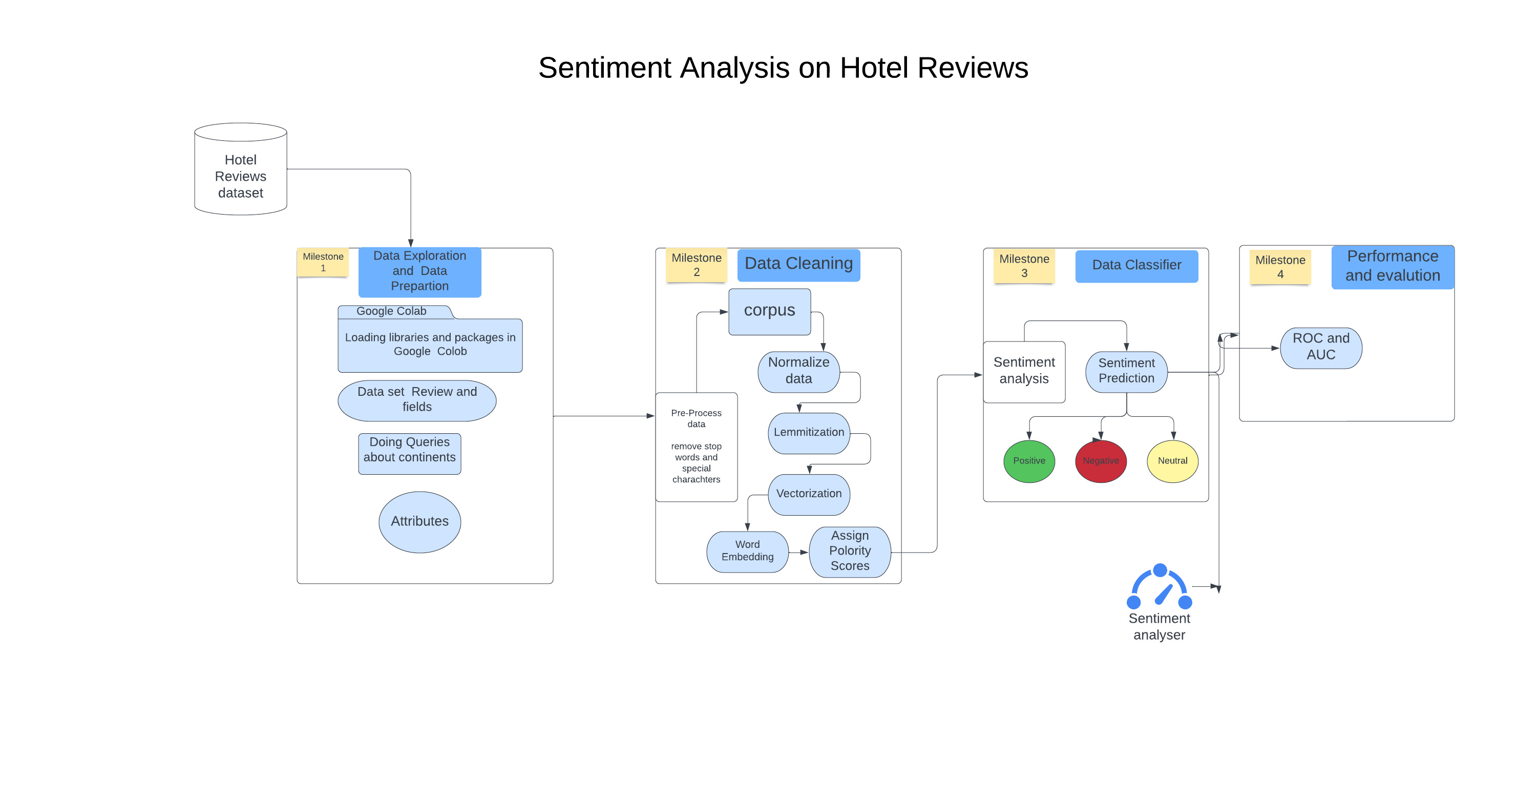
System Architecture
Notes:
Milestone 1 : Explore data set and prepare data and loading all the required libraries.
Milestone 2 : Here initially stop words and special characters are removed. And then we go through these stages for the data cleaning.
Milestone 3 : In this stage we do the sentiment analysis prediction with Random Forest classifier and transformers using Roberta.
Milestone 4 : Performance evaluation using ROC and AUC Curve.

Slide 9
Dataset
The data was scraped from Booking.com. All data in the file is publicly available to everyone already. Please be noted that data is originally owned by Booking.com.
This dataset contains 515,000 customer reviews and scoring of 1493 luxury hotels across Europe. Meanwhile, the geographical location of hotels is also provided for further analysis
The following attributes are considered as our dataset:
Hotel-Address ReviewTotalPositiveWordCounts
Review-Date Average-Score
Hotel-Name Reviewer-Nationality
Negative-Review ReviewTotalNegativeWordCounts
Positive-Review ReviewTotalPositiveWordCounts
Reviewer-Score TotalNumberofReviewsReviewerHasGiven
TotalNumberof-Reviews Tags
Dayssincereview AdditionalNumberof-Scoring
Latitude Longitude
Notes:
Here we have collected the data set from Booking.com which has these many customer reviews across Europe
These are the data fields present in out dataset.

Slide 10
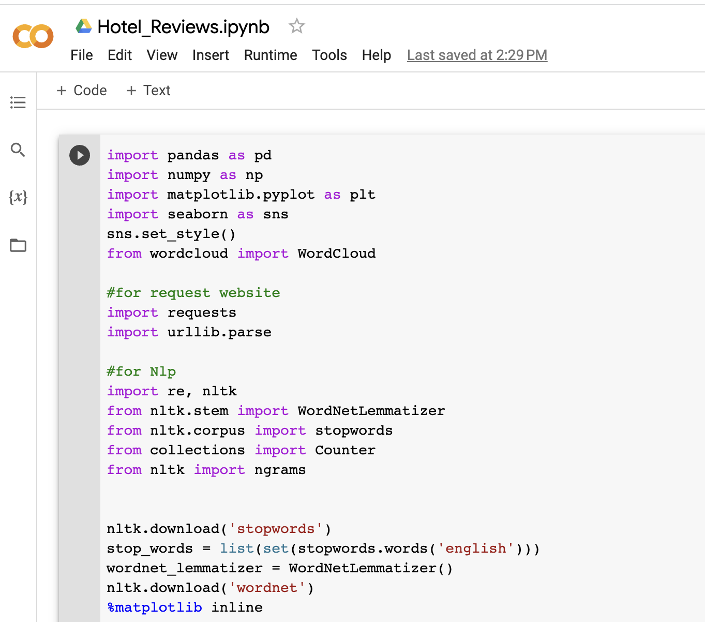
Workflow
Milestone 1: Data Exploration & Preparation
Notes:
So coming to the Milestone 1: We have imported all the necessary library files like pandas, numpy, matplot, seaborn that are required for out project.

Slide 11

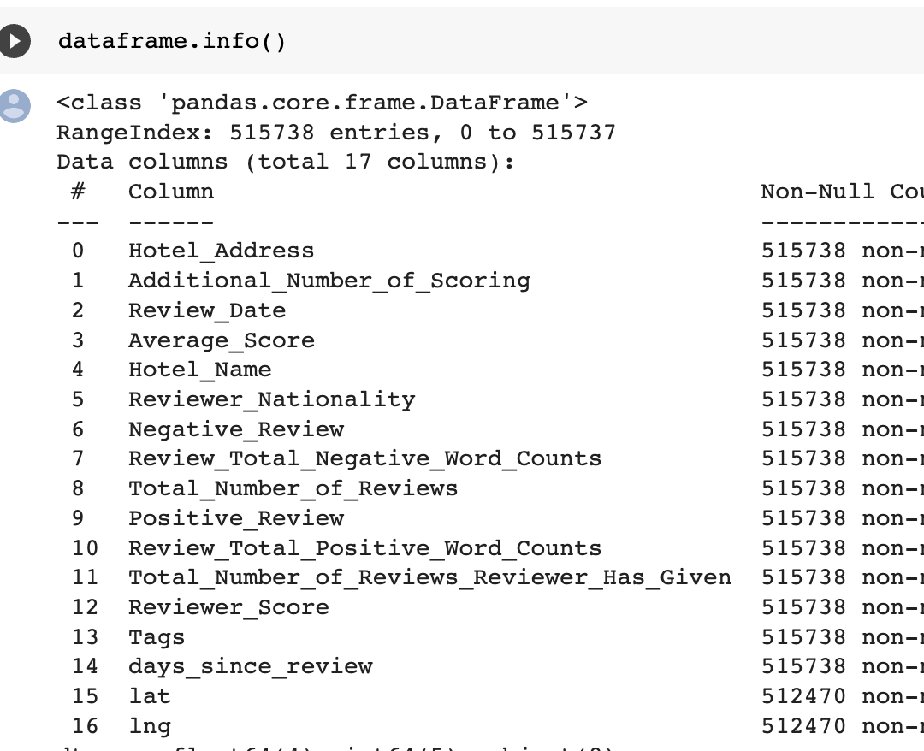
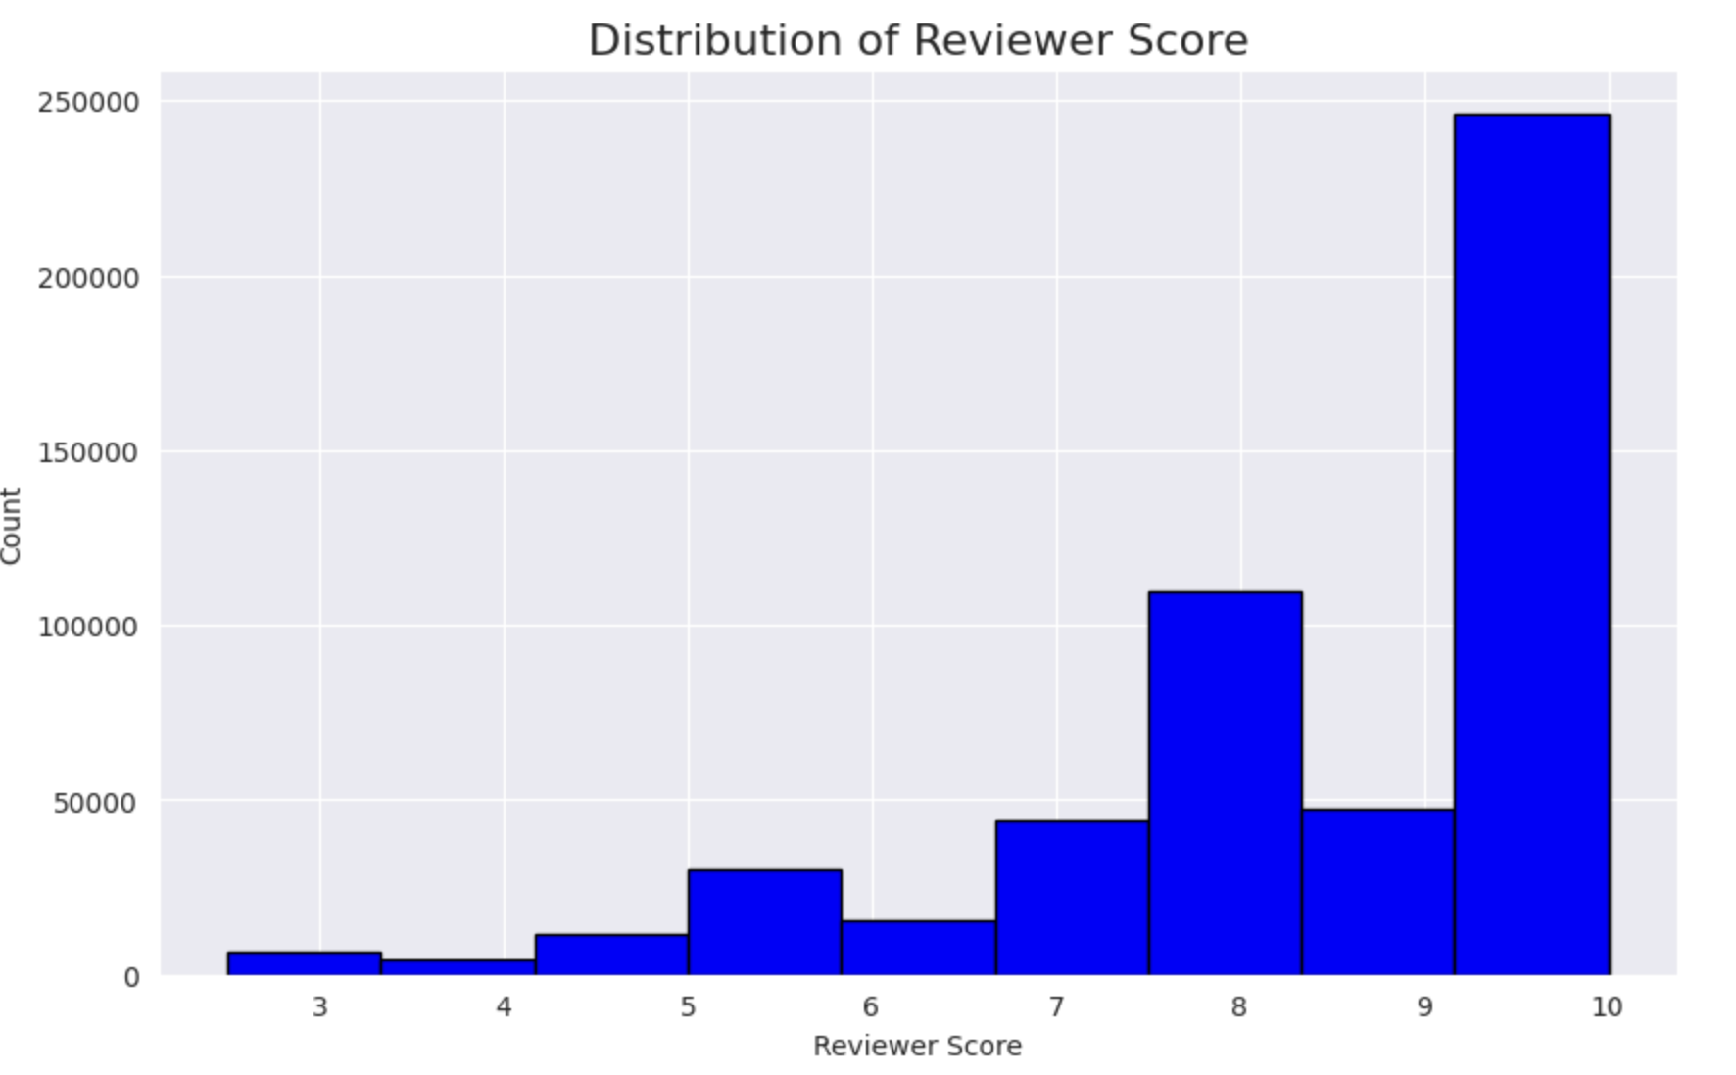
Workflow
Data Description
The data has been taken from booking.com, kaggle site and contains the following fields
Notes:
These are the datasets present in the dataset we have considered. Data taken from Booking.com

Slide 12
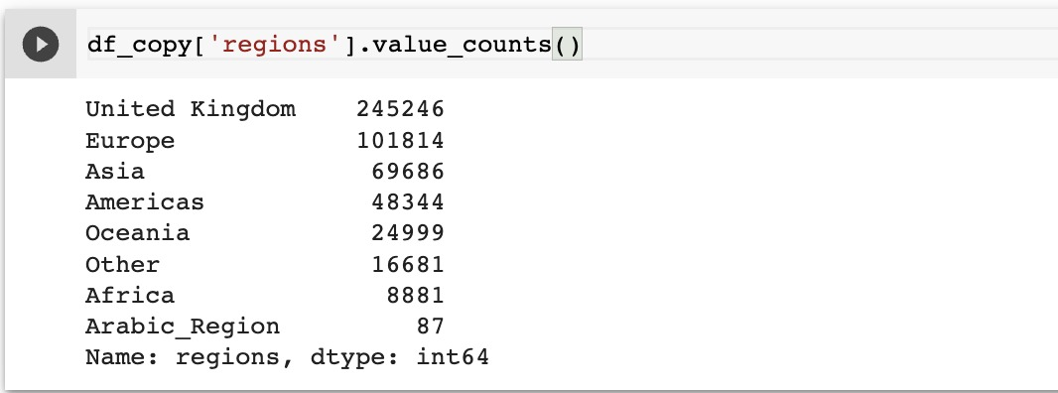
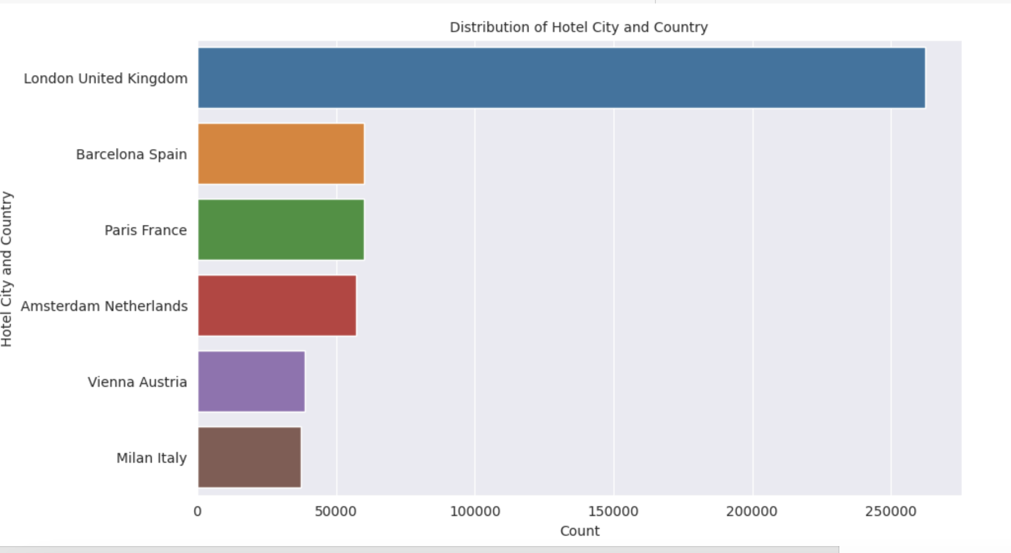
CONTD..
Added a new column ”Region” to our data set by using countryContinent.csv file to find from which country/state most of the people visited the hotel.
Notes:
Here we have added a new column “Region” To identify the origin of customer from which country or city they have come from.

Slide 13
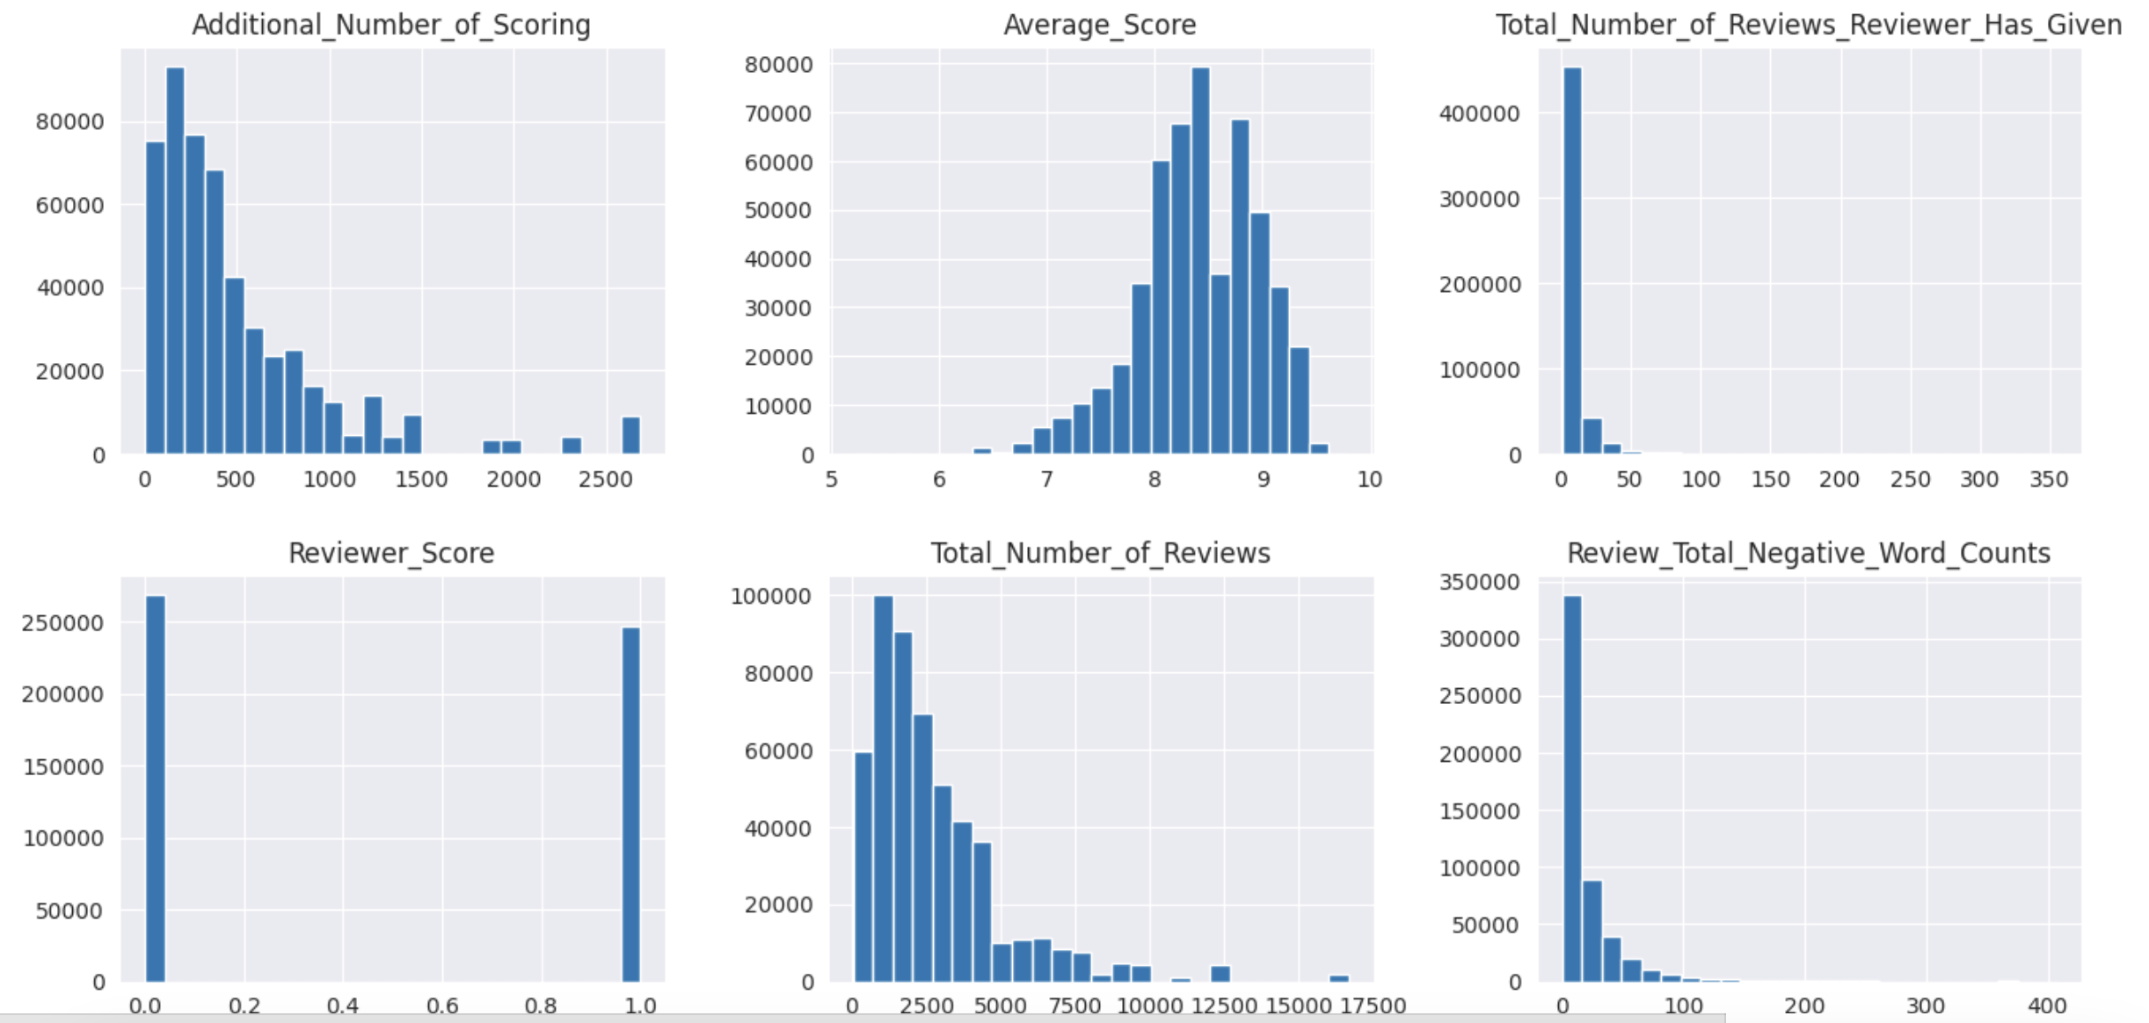
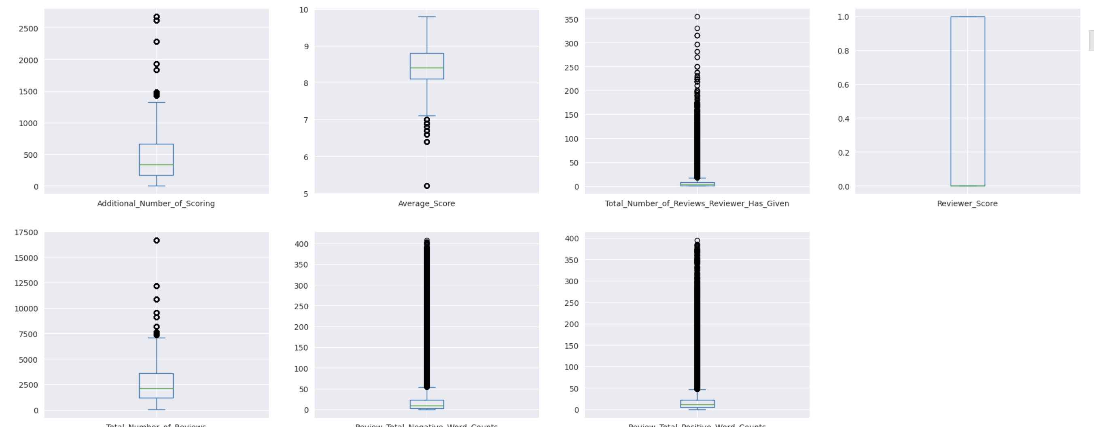
CONTD
From the histogram we can observe we have abnormality in the range of values of some columns.
Box plots has given the confirmation about the outliers
The outliers of the data will be removed during the data cleaning stage.
Notes:
Here we can see the abnormality in the range of values of some columns.

Slide 14
DATA CLEANING
Steps followed for data cleaning:
Remove no negatives and no positives from data
Clean textual data using
Parts of speech
Word lemmatization
Notes:
Data cleaning is the fundamental step in any NLP techniques. The above code represents that we are doing the following,
Convert the sentences to lower case letter as a step for preprocessing.
Remove special symbols like “”, !@#$ in our data.
Remove stop words and remove tokens like tags.
Tokenization, lemmatization

Slide 15
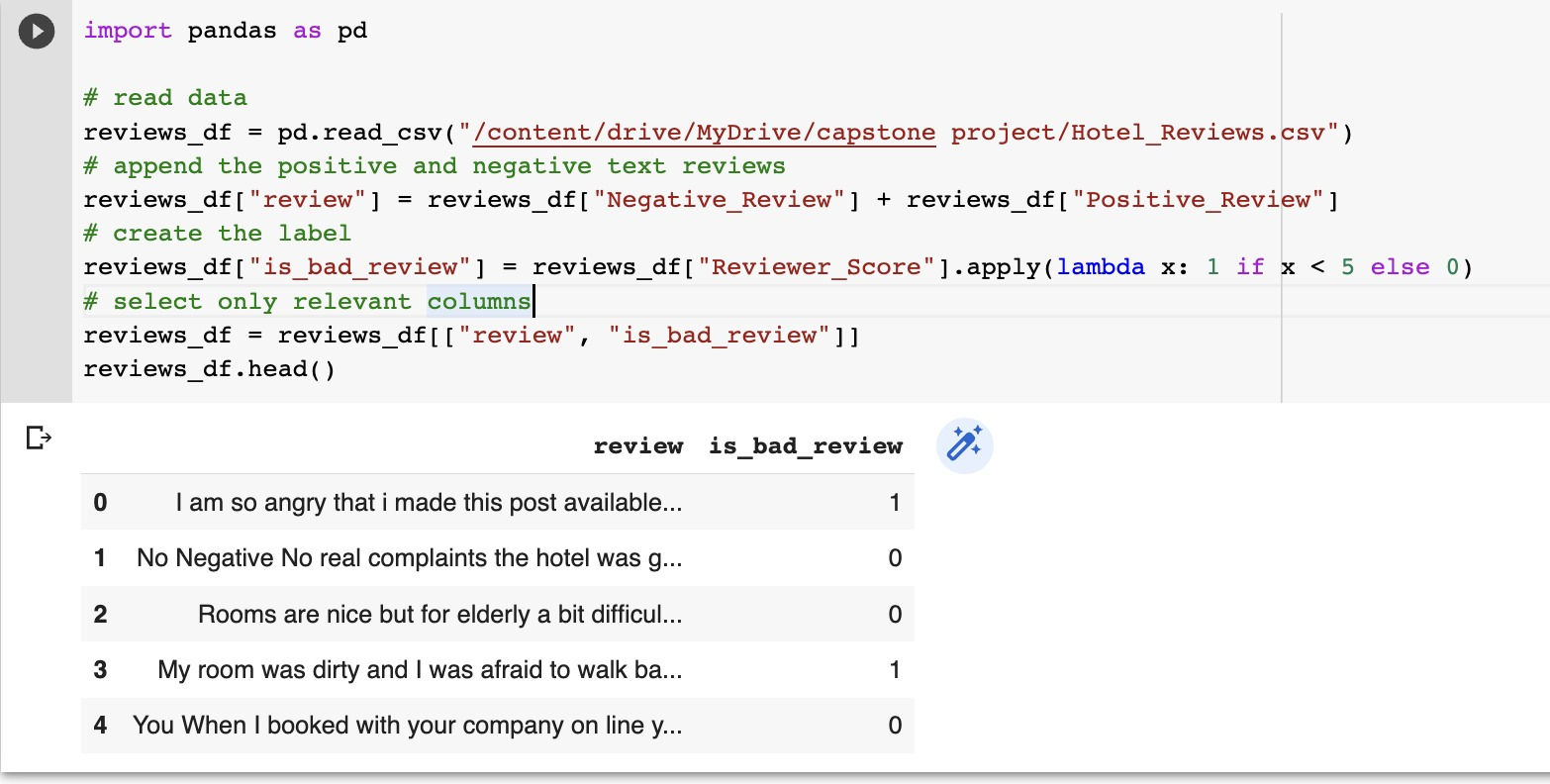
CONTD..
Using lambda function, we differentiated positive and negative reviews
Notes:
We first start by loading the raw data. Each textual reviews is splitted into a positive part and a negative part. We group them together in order to start with only raw text data and no other information.
0 – positive review 1- negative review
Rating scale: 0-10
x<5 -> bad review
X>5 -> good review

Slide 16
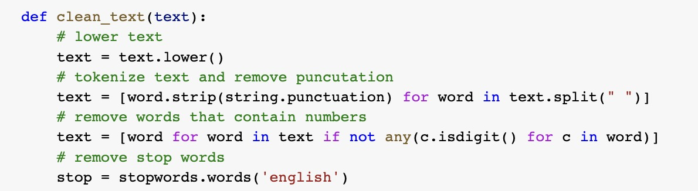
CONTD..
Convert the sentences to lower case letter as a step for preprocessing.
Remove special symbols like “”, !@#$ in our data.
Remove stop words and remove tokens like tags.
Notes:
Stop words are a set of commonly used words in any language. For example, in English, “the”, “is” and “and”, would easily qualify as stop words.

Slide 17
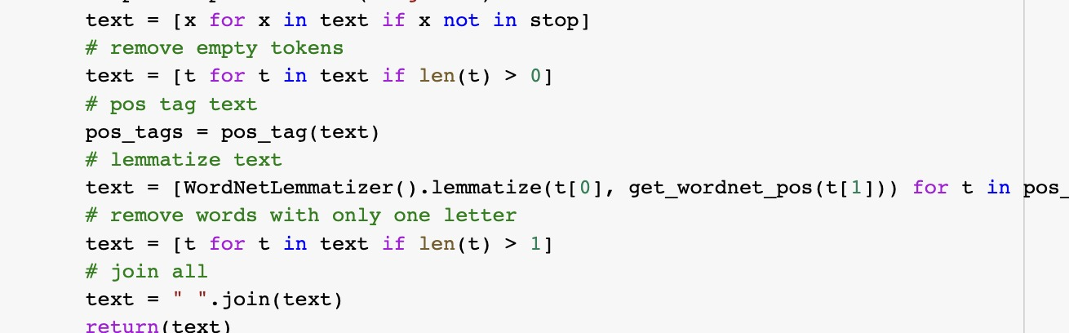
CONTD..
Assign a tag to every word to define if it corresponds to a noun, a verb etc. using the WordNet lexical database
Lemmatization is used to switch any kind of a word to its base root mode
Notes:
Part-Of-Speech (POS) tagging: assign a tag to every word to define if it corresponds to a noun, a verb etc. using the WordNet lexical database

Slide 18
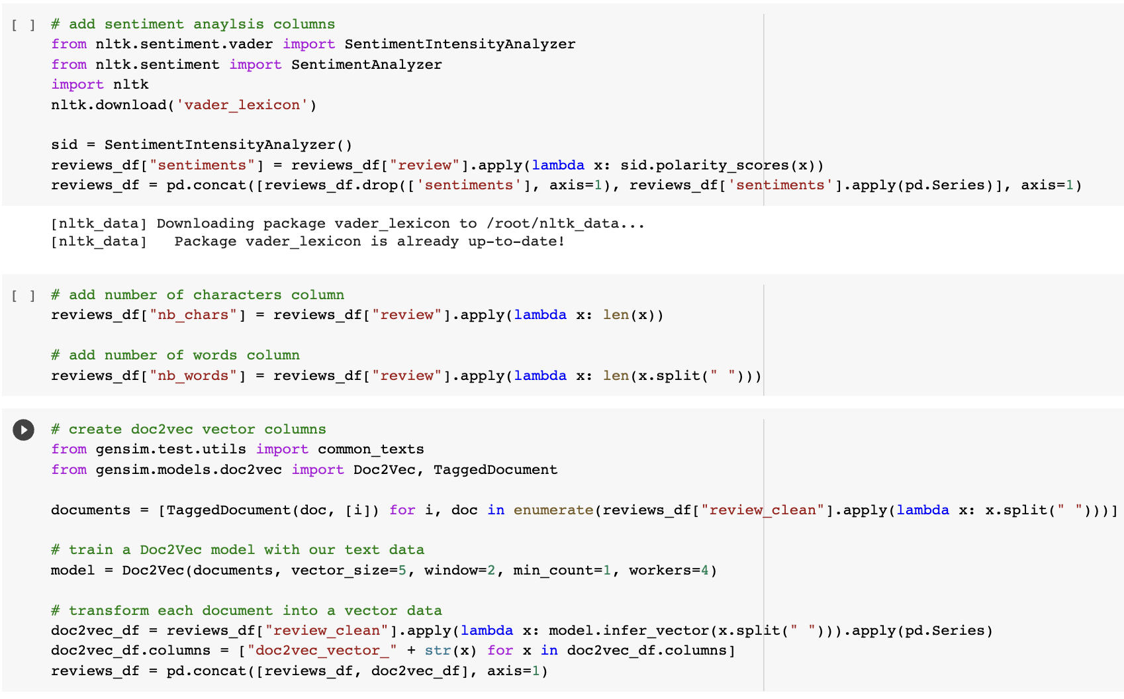
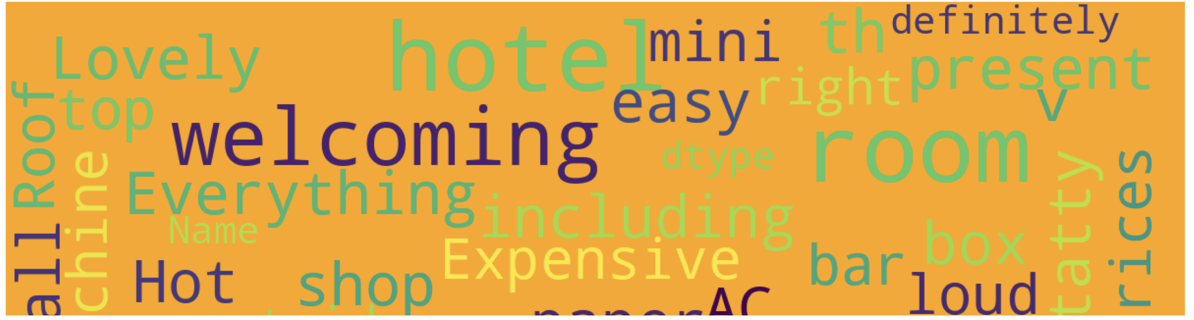
CONTD..
SentimentIntensityAnalyzer to find out sentiments score on the vectors that we obtained after processing the data.
Using gensim module to convert the text to vectors using DOC2VEC function
By using SentimentIntensityAnalyzer we find the polarity scores and plot word cloud.
The picture represents word cloud representation of most used words
Notes:
Vader searches through his vocabulary to determine which words are positive or negative. To calculate the sentiment scores, it additionally considers the sentence context.

Slide 19
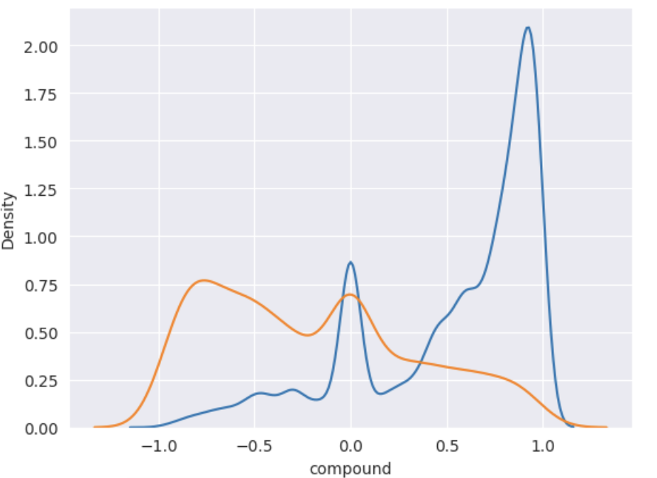
CONTD..
Graph shows the distribution of good reviews and bad reviews.
Note: Blue line indicates positive review, Orange line indicates negative review in the graph

Slide 20
CLASSIFIER
Random forest is a flexible, easy to use machine learning algorithm that produces, even without hyper-parameter tuning, a great result most of the time.
Sklearn RandomForestClassifier can be used for determining feature importance.
The n_estimators parameter specifies the number of trees in the forest of the model.
Random state parameter is used to set the seed for the random number generator used to select features and samples when building each decision tree.
Notes:
1. Each tree gets the full set of features, but at each node, only a random subset of features is considered.

Slide 21
CONTD..
Feature randomness generates a random subset of features, which ensures low correlation among decision trees. This is a key difference between decision trees and random forests.
To create feature names
df dataframe importances_df = pd. DataFrame({"feature_names" : rf. feature_names_in_, "importances" : rf.
Notes:
1. Each tree gets the full set of features, but at each node, only a random subset of features is considered.

Slide 22
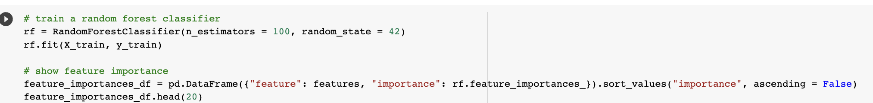
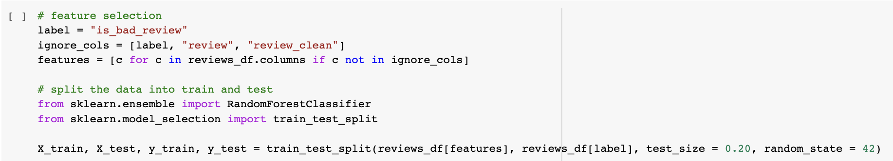
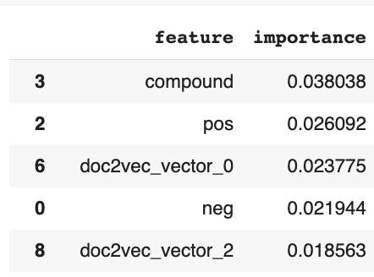
CODE FOR RANDOM FOREST

Slide 23
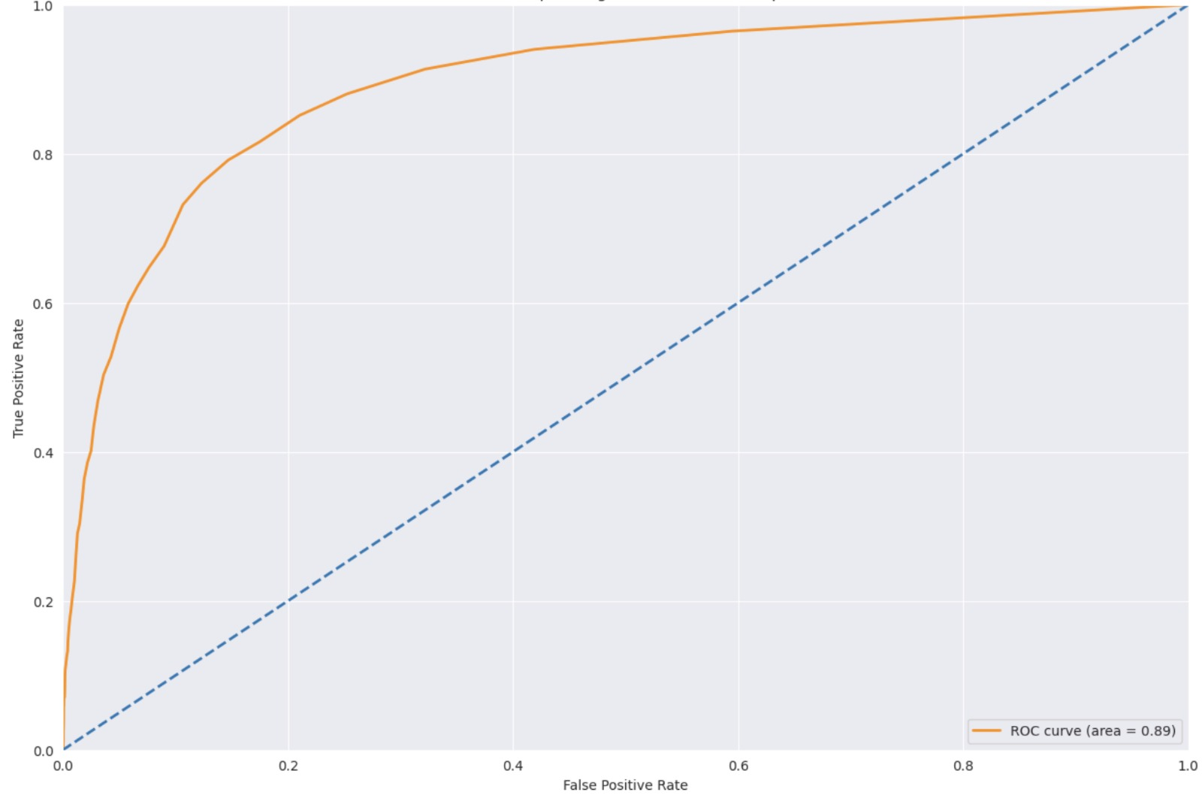
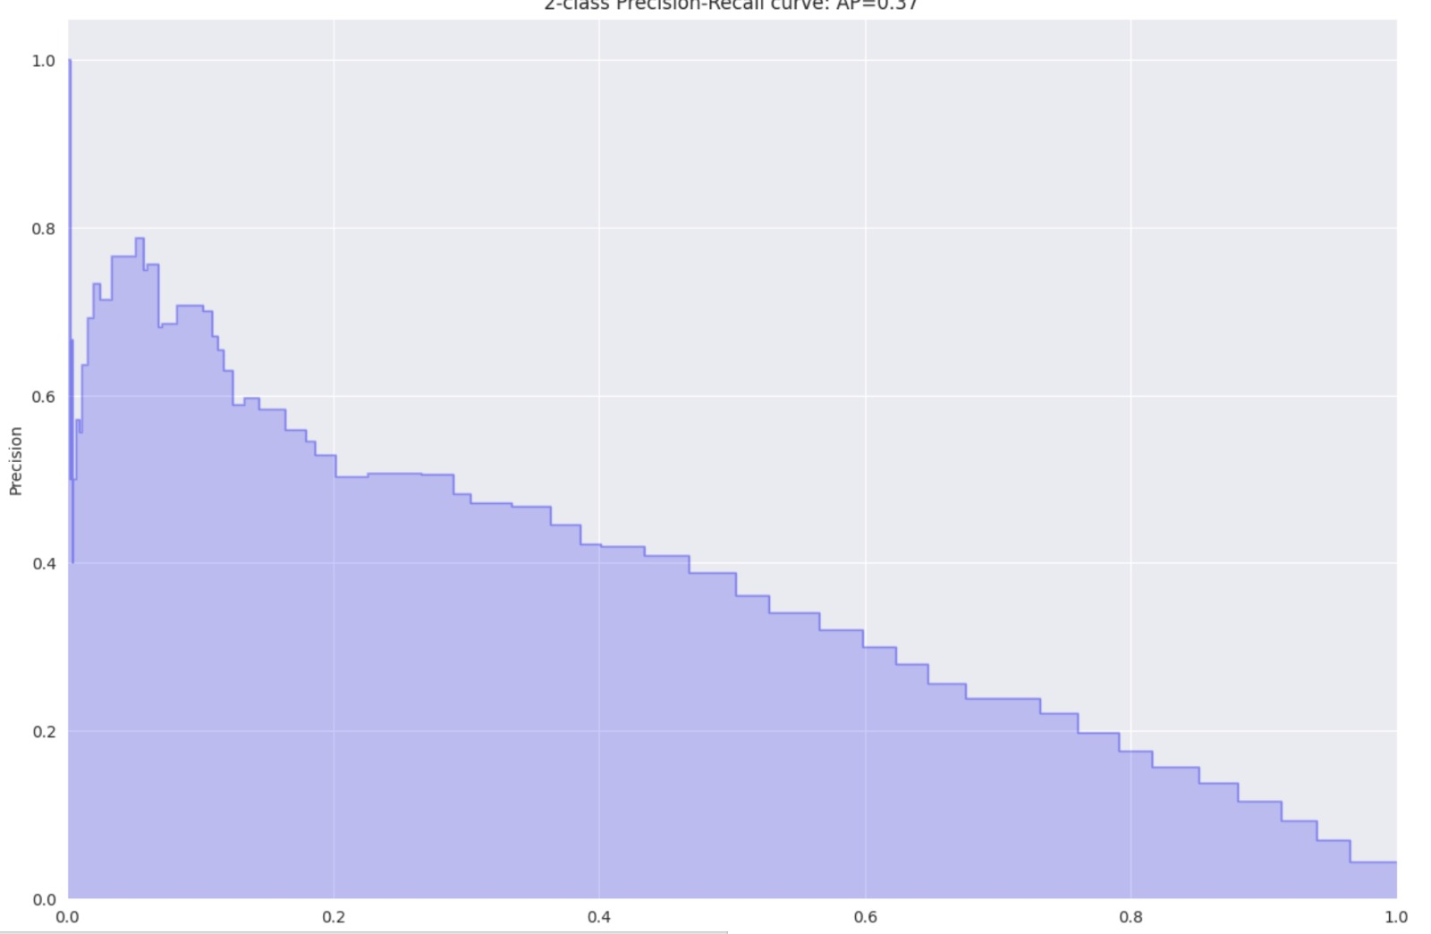
Performance & Evaluations
ROC CURVE
The ROC (Receiver Operating Characteristic) curve is usually a good graph to summarize the quality of our classifier
PR CURVE
To assess the quality of our model, we compare it to a simple decision baseline. Let's take a random classifier as a baseline here that would predict half of the time 1 and half of the time 0 for the label.
Notes:
The higher the curve is above the diagonal baseline, the better the predictions
ROC Curve value: 0.89
PR Curve , AP Score: 0.37

Slide 24
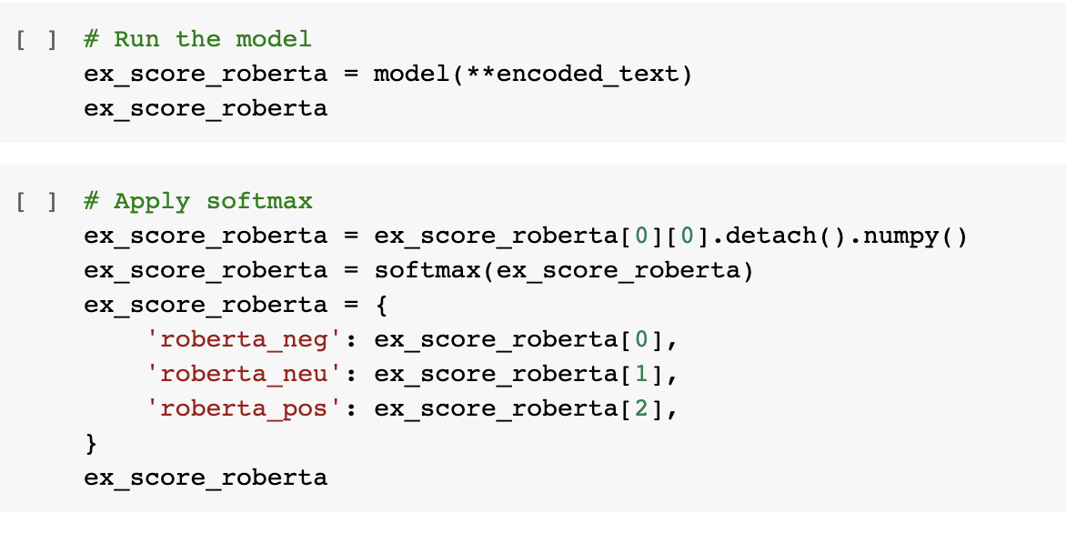
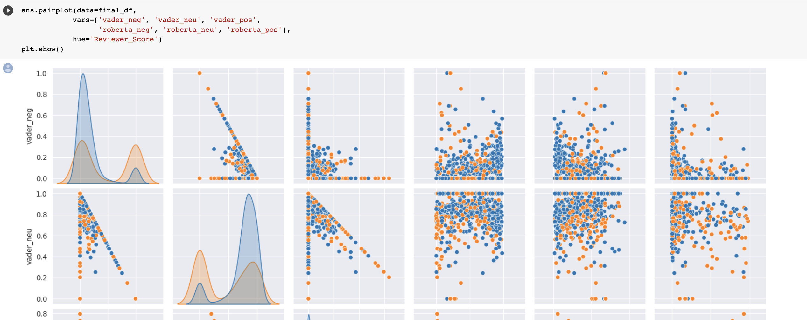
RoBERTa
RoBERTa (Robustly Optimized BERT Pretraining Approach) is a natural language processing (NLP) model that uses the transformer architecture to learn contextual relationships between words in a sentence.
RoBERTa uses a masked language modeling (MLM) objective during pretraining to learn the underlying relationships between words and their contexts
Notes:
It is a modified version of the BERT (Bidirectional Encoder Representations from Transformers) model that is trained using additional data and longer training times, resulting in improved performance on various NLP tasks
and fine-tuning is then performed on downstream tasks such as sentiment analysis and question answering. # highest positive sentiment reviews (with more than 5 words)
Dynamic Masking: BERT uses static masking i.e. the same part of the sentence is masked in each Epoch. In contrast, RoBERTa uses dynamic masking, wherein for different Epochs different part of the sentences are masked. This makes the model more robust

Slide 25

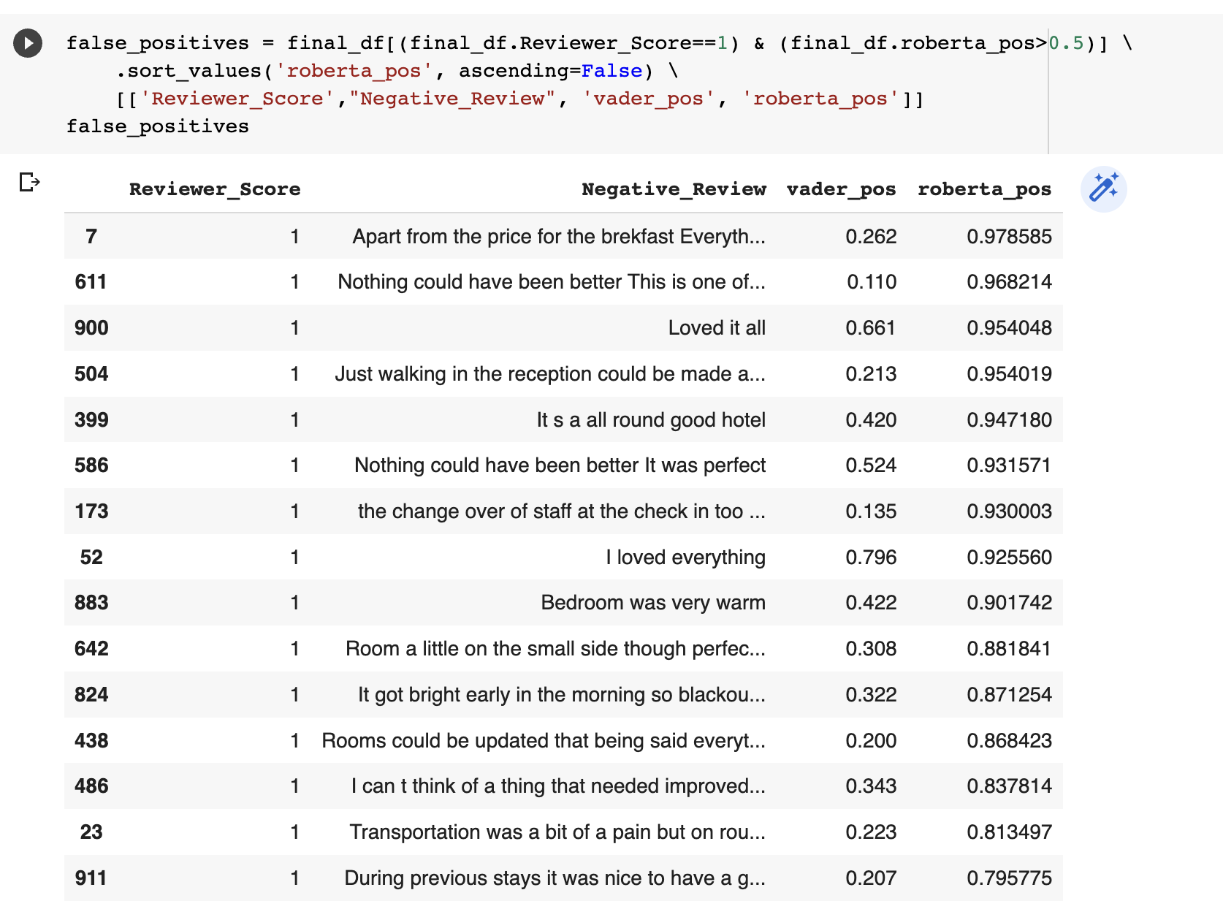
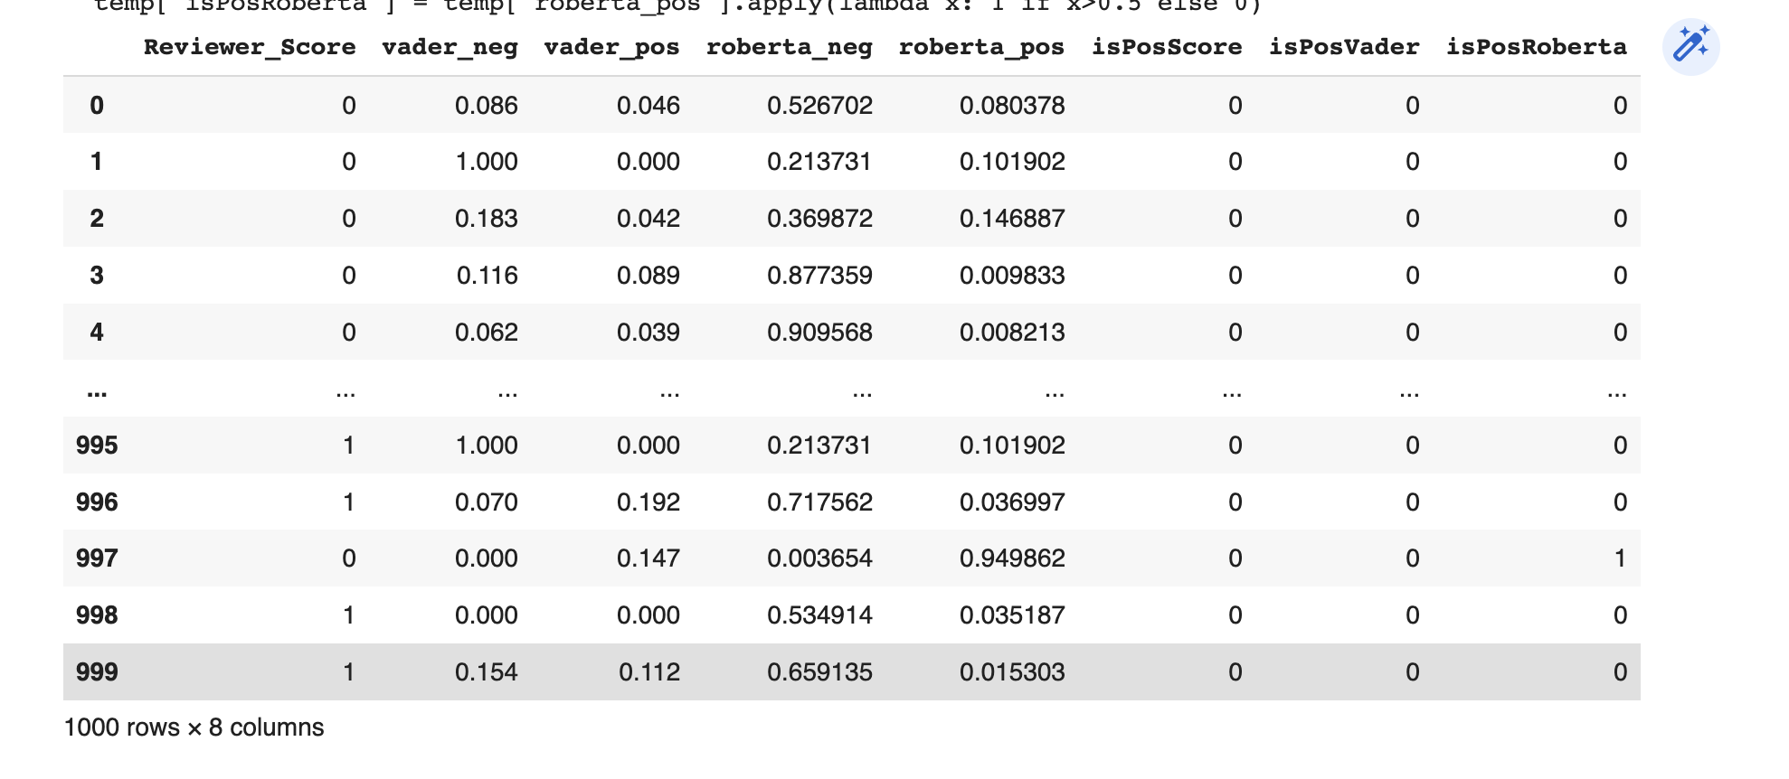
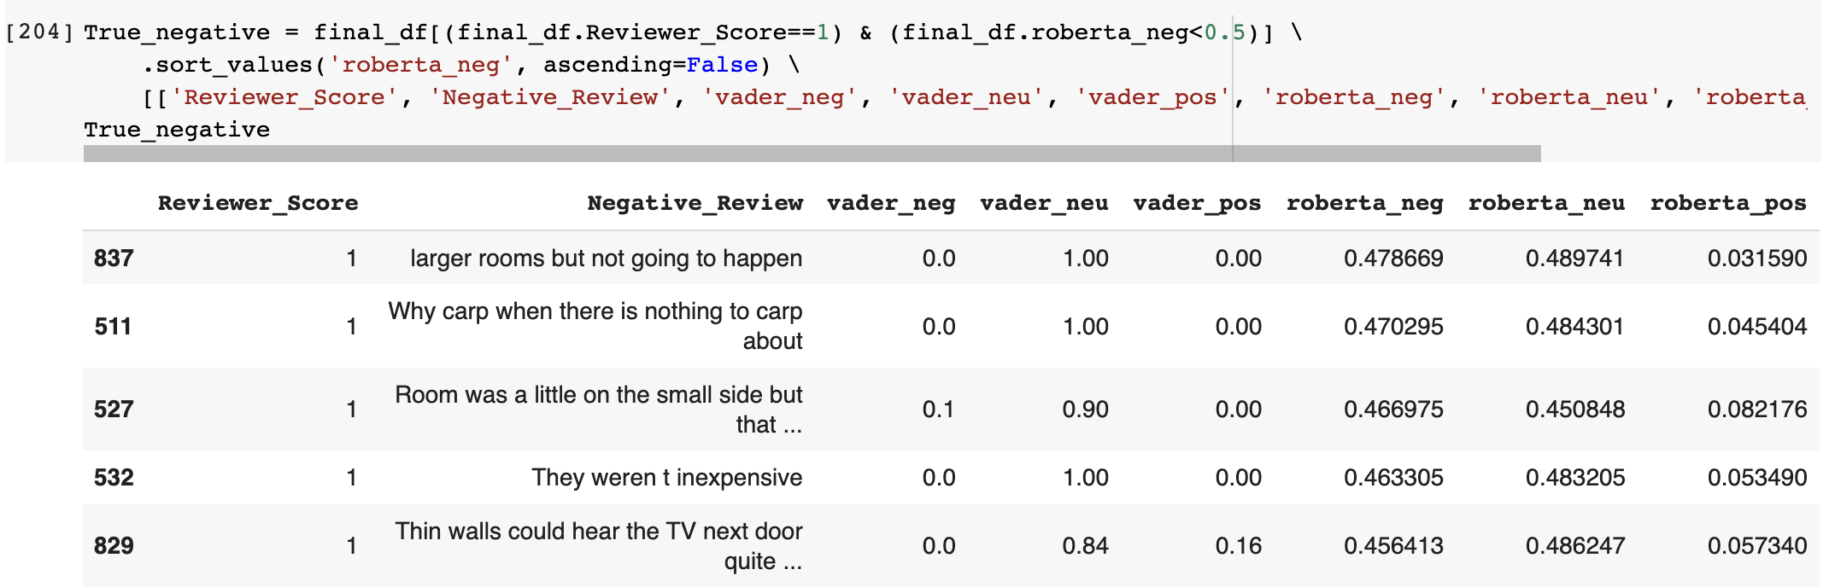


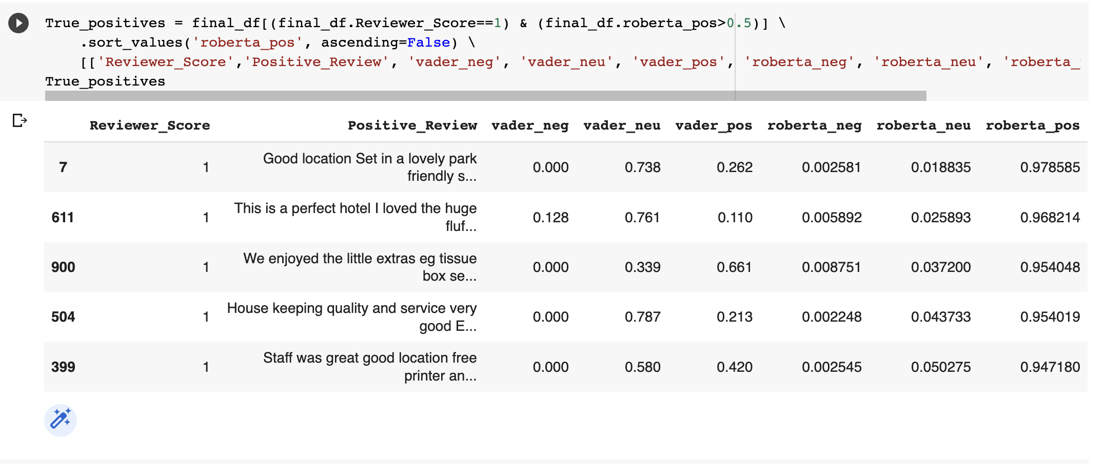
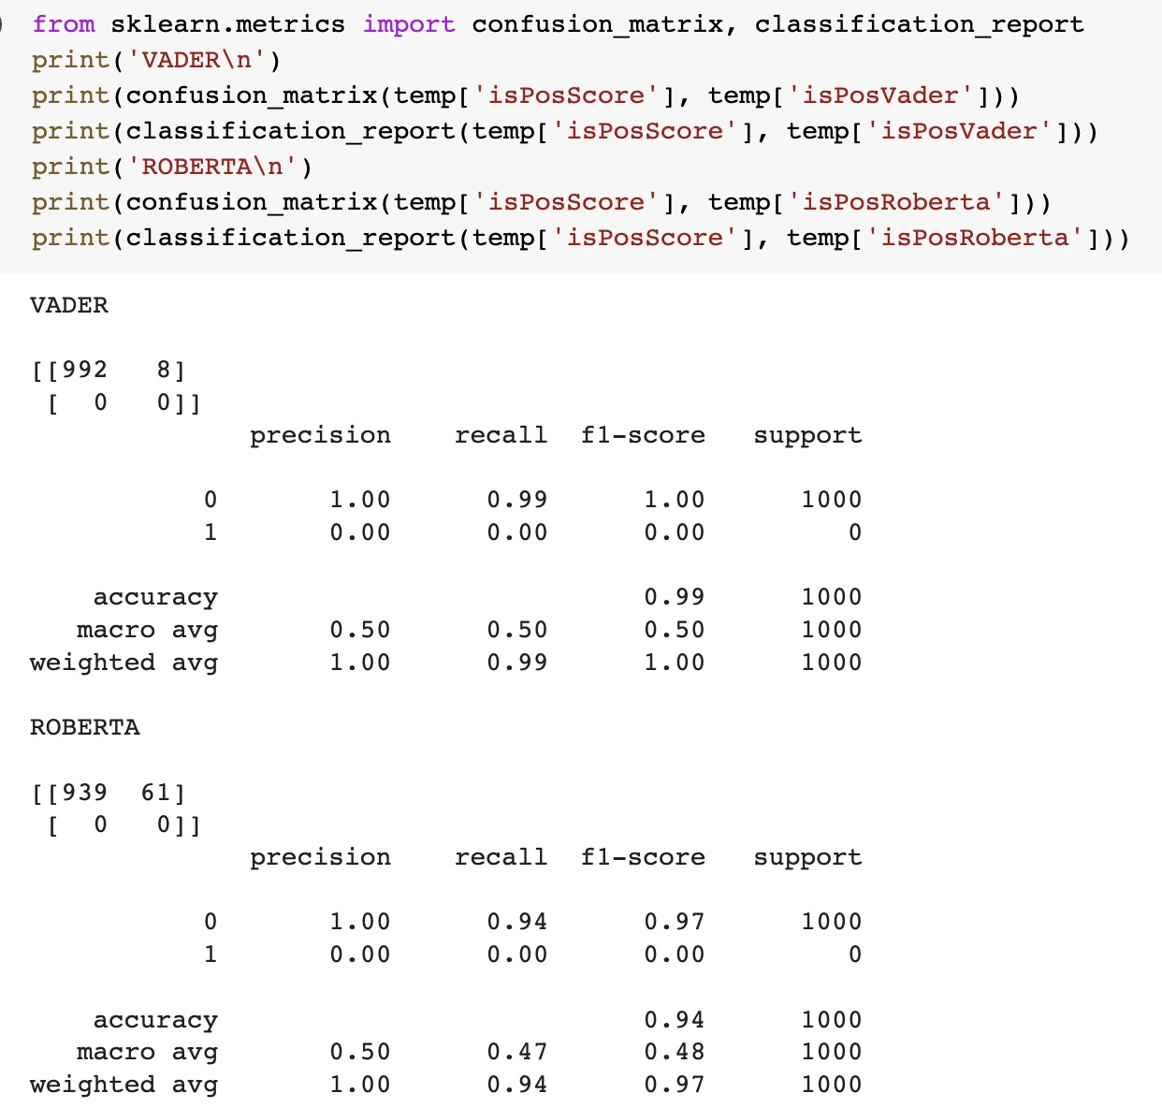

CONTD..

Slide 26
CONTD..
The accuracy obtained for Random Forest classifier is 0.89(ROC Curve) and 0.36(PR Curve)
The accuracy for Vader is 0.99 and for Roberta its 0.94
Random Forest Classifier
N- Estimators | Random State | ROC Curve Accuracy | PR Curve Accuracy
100 | 42 | 0.89 | 0.36
95 | 32 | 0.88 | 0.31
100 | 35 | 0.87 | 0.31
100 | 30 | 0.88 | 0.31
100 | 35 | 0.87 | 0.33
95 | 34 | 0.88 | 0.32
100 | 36 | 0.88 | 0.34
100 | 38 | 0.88 | 0.32
90 | 42 | 0.88 | 0.31
95 | 42 | 0.88 | 0.32
Vader
 | Precision | Recall | F1 score | Support | Acccuracy
0 | 1 | 0.99 | 1 | 1000 | 0.99
1 | 0 | 0 | 0 | 0
ROBERTA
 | Precision | Recall | F1 score | Support | Acccuracy
0 | 1 | 0.94 | 0.97 | 1000 | 0.94
1 | 0 | 0 | 0 | 0

Slide 27
THANK YOU

